Slide 1
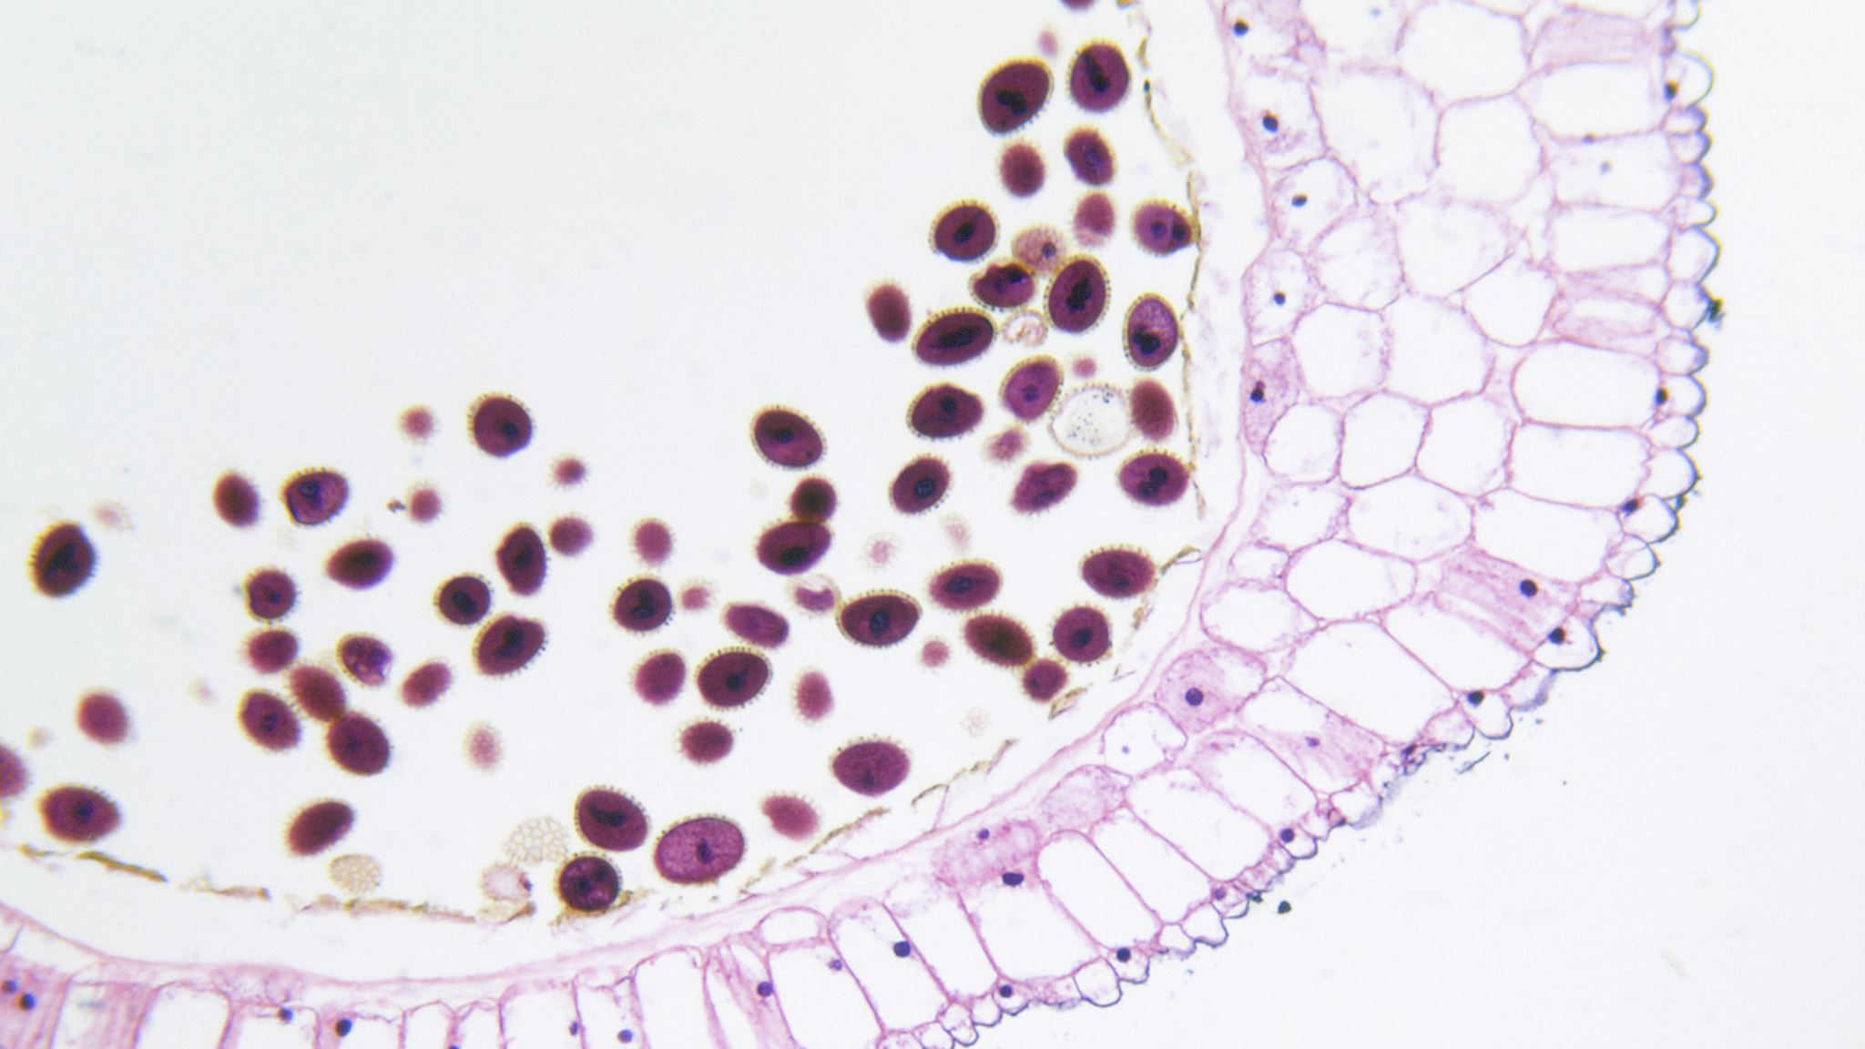
Anatomy and Physiology of the Skin
Dr Tampaki Ekaterini Christina, Plastic and Reconstructive Surgeon
Dr Filippou Dimitrios, Assistant Professor- General Surgeon
Dr Sinou Natalia, PhD candidate

Slide 2
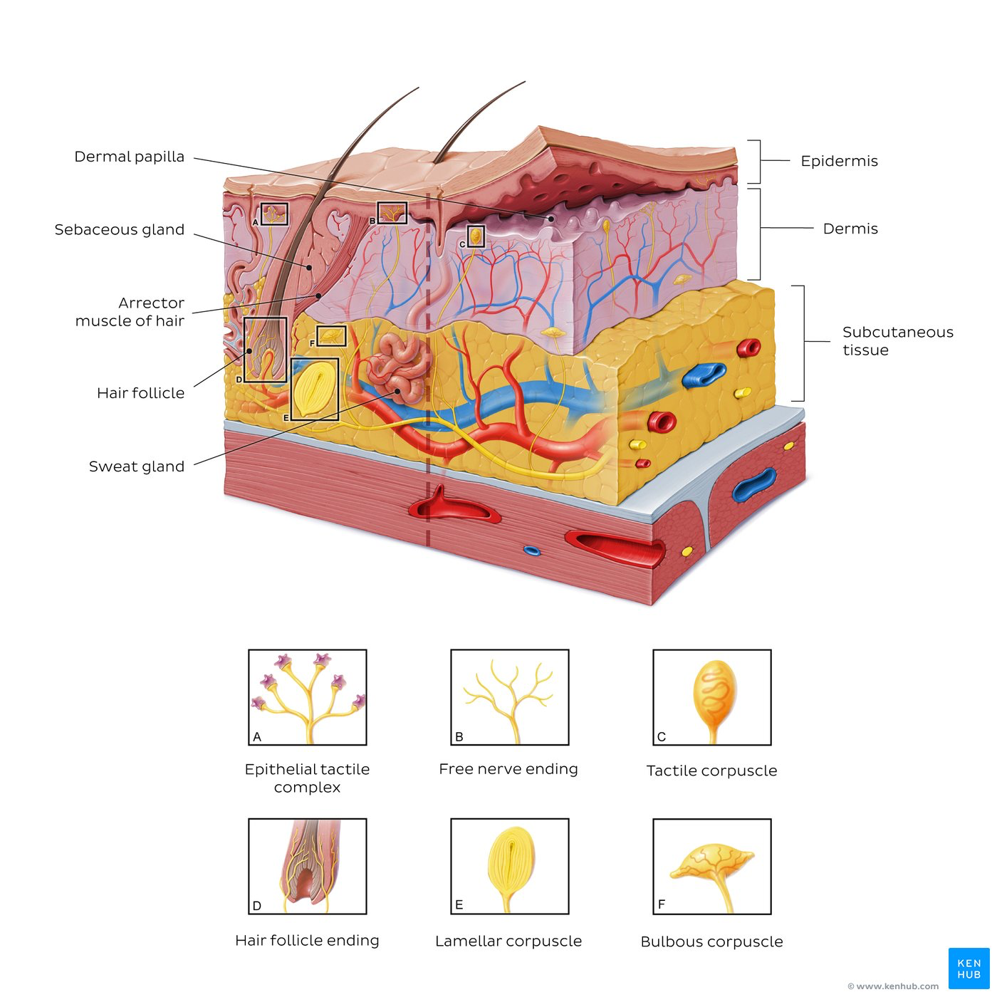
What is Skin?
Skin = Integument
The body’s largest organ contributing to one sixth of the total body weight.
Covers 20 square feet in area (adult)
Three primary layers:
Epidermis
Dermis
Subcutaneous tissue: adipose tissue beneath dermis.
Deep (muscular) fascia: thick fascia between subcutaneous tissue and underlying muscles.
Skin appendages: Hair, nails, sweat glands, sebaceous glands.

Slide 3
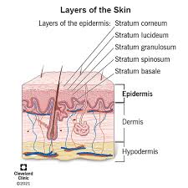
Epidermis
The outmost/top layer of the skin (protective layer)
Has an average thickness of 0.1mm (15-100 cell layers)
Avascular (no blood vessels)
Made up of stratified squamous keratinizing epithelium
Divided into five sub layers:
Stratum corneum
Stratum lucidum
Stratum granulosum
Stratum spinosum
Stratum basale
Four (thin skin) versus five (thick skin) areas of epidermis comes in.

Slide 4
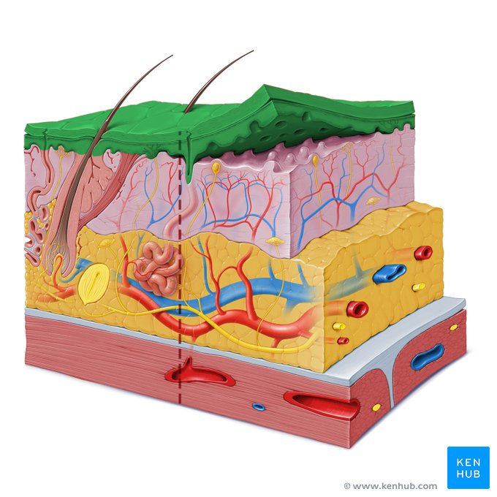
Epidermal Layer
Contains four distinct layers of cells:
Keratinocytes – produce keratin
Melanocytes – pigment producing cells
Same number in all skin colors
Size and activity greater in darker skin (skin color based on the amount produced)
Cells in dark skin more compact therefore skin more resistant to injury
Merkel Cells – they let you feel light touch
Langerhan Cells – are part of the immune system
The external layer is almost completely replaced every three to four weeks (continually shedding and reviewing)

Slide 5
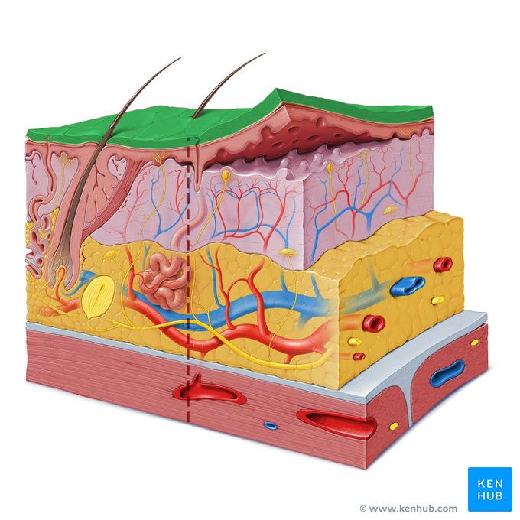
Epidermis: Stratum Corneum
Avascular
Made up of mature keratinocytes
Multilayer (up to 20 cell layers matured or keratinized): keratinized squamous epithelium
Function
Fights infections
Protects against : chemical damage, wear and tear, dehydration. Barrier to environment and prevents transepidermal water loss:
Dressing adhesives can strip stratum corneum and cause transepidermal water loss
Involved in formation of an acid mantle:
Makes skin less permeable to water.
Protects skin from microorganism invasion.

Slide 6
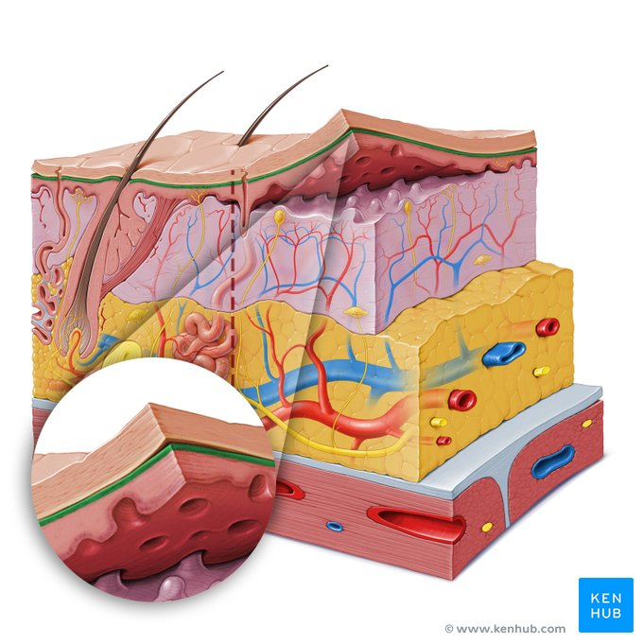
Epidermis
Statum Lucidum
Stratum Granulosum
Lucid = clear. Appears cleared on histological slides.
The second layer of the epidermis can only be found in areas of your body where the skin is thicker
Palms of the hands
Soles of the foot
Granular layer
Comprised of mature keratinocytes containing granules in their cytoplasm.
No nuclei: in this layer the keratinocytes lose their organelles including their nuclei and then they die.

Slide 7
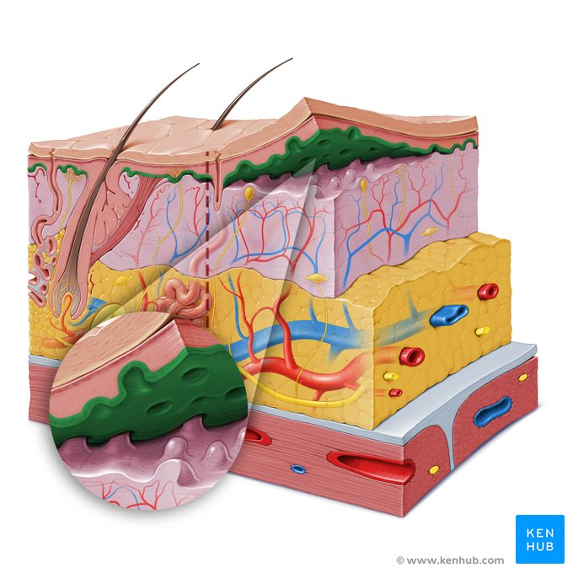
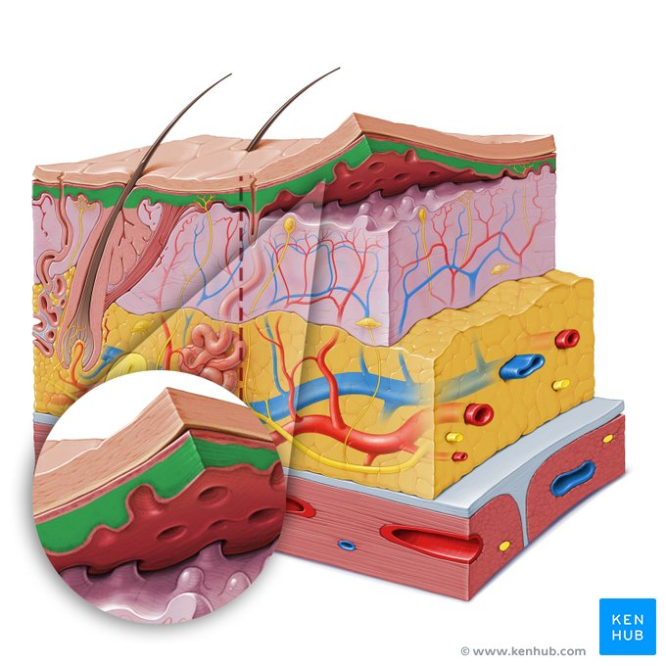
Epidermis
Stratum Spinosum
Stratum Basale
Desmosomes
Spiney
Antigen presenting dendritic cells: Langerhans cells (most abundant in this layer, although they can be found in other layers)
The cells here are attached to the basement membrane below the hemidesmosomes
Cells both devide and grow in this layer
Keratinocytes originate from this layer
Contains melanocytes – produce pigment that gives skin, hair, eyes their color.

Slide 8
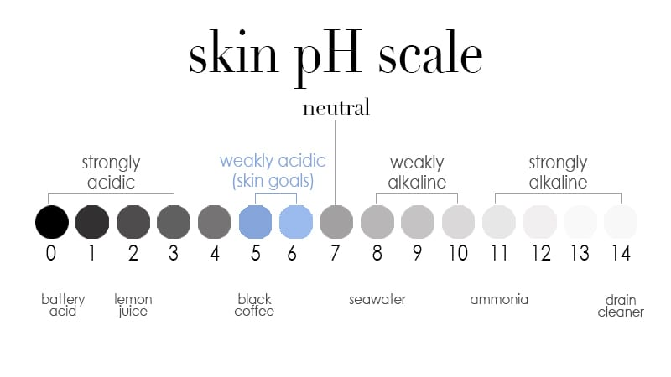

Slide 9
Acid Mantle
Damage to the skin increases it’s pH and risk of infection
Diseases/conditions associated with increased skin pH:
Eczema
Dermatitis
Dry skin
Diabetes
Chronic renal failure
CVD
Urine, stool, perspiration on the skin increases it’s pH

Slide 10
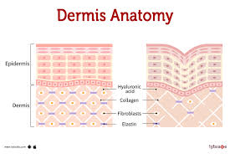
Dermis
Immediately below the basement membrane of the epidermis (nourishes, supports, sustains the epidermis)
Fibroblasts, collagen, macrophages, mast cells
Largest portion of the skin
Composed of two layers:
Papillary Dermis -- Stratum Papillare (superficial):
Reticular (deep):
Blood vessels
Collagen fibers
Connective tissue

Slide 11
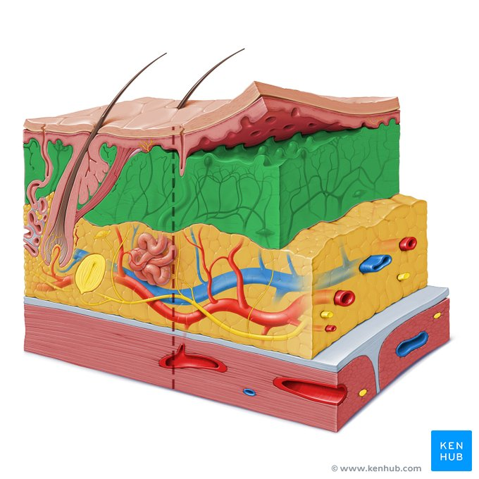
Dermal Layer
Made up of blood (vessel plexus) and lymph vessels, nerves, sweat and sebaceous glands and hair roots
Often referred to as true skin
Functions:
Provides tensile strength, mechanical support and protection to the underlying muscles, bones, and organs
Regulates temperature
Senses the environment

Slide 12
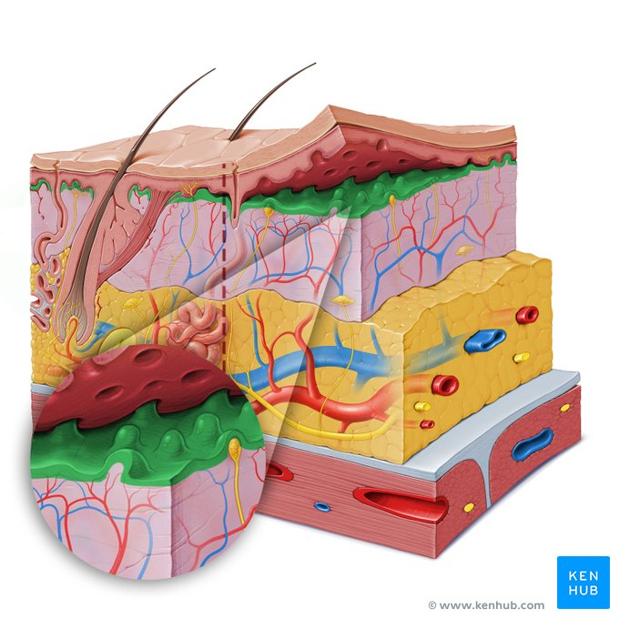
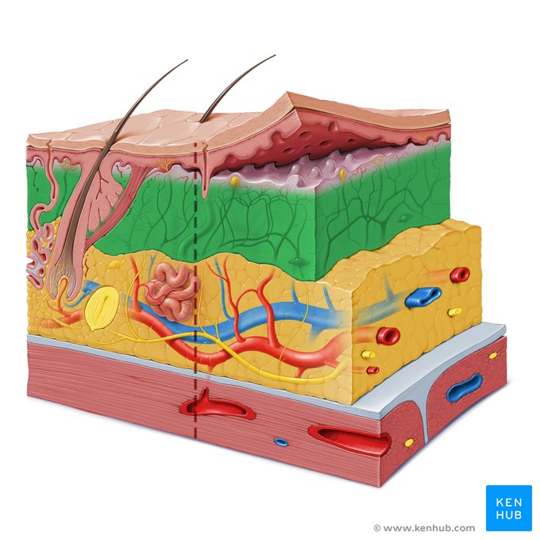
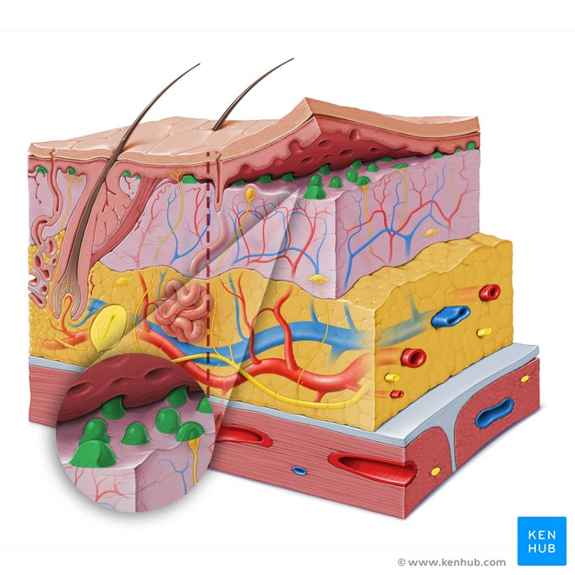
Reticular Dermis – Stratum Reticulare
Papillary Dermis- Stratum Papillosum
Is composed of thicker connective tissue which surrounds:
The hair follicles of the skin
Sweat glands
Sebaqeous glands
Nerves
Blood vessel plexus
Contains fibroblasts, collagen (strength and resistance) and elastic fibers
The papillae increase the surface area for the transfer of nutrients and oxygen to the epidermis.
It is made up of loose connective tissue – areolar connective tissue

Slide 13
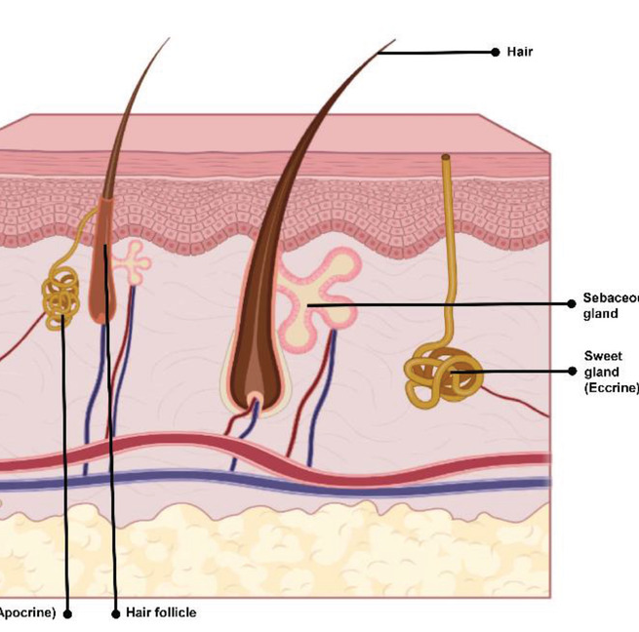
Dermal Appendages
Includes:
Hair follicles
Sebaceous and sweat glands (lubricate, control pH, temperature)
Fingernails and toe nails
Originates in dermis and protrude into the epidermis
Contribute epithelial cells for reepithelialization

Slide 14
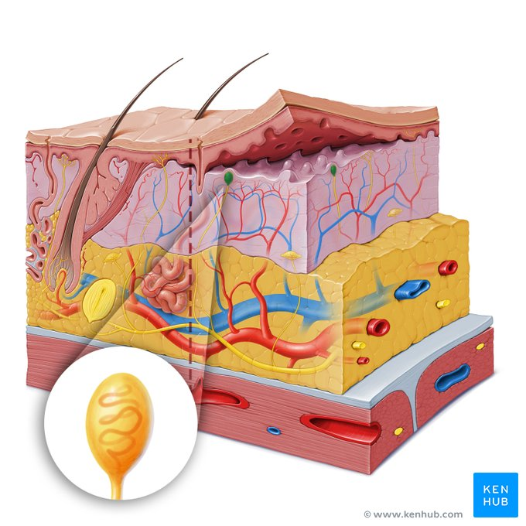
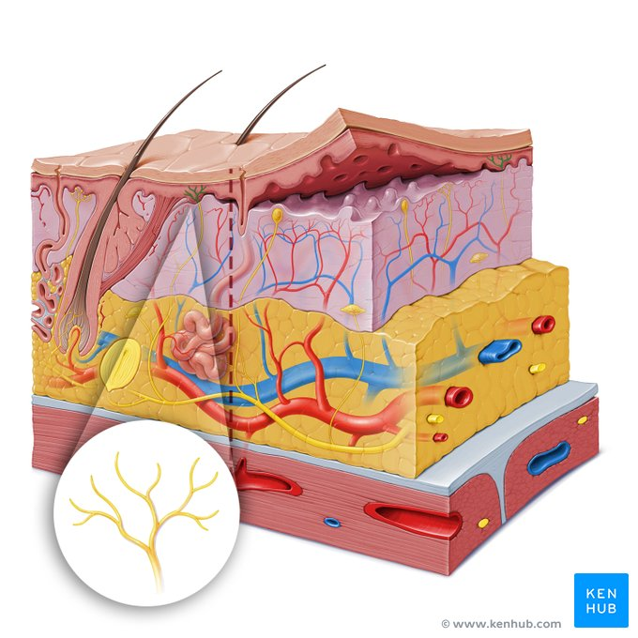
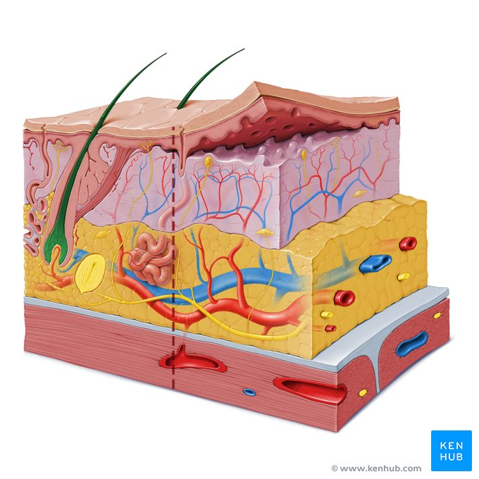
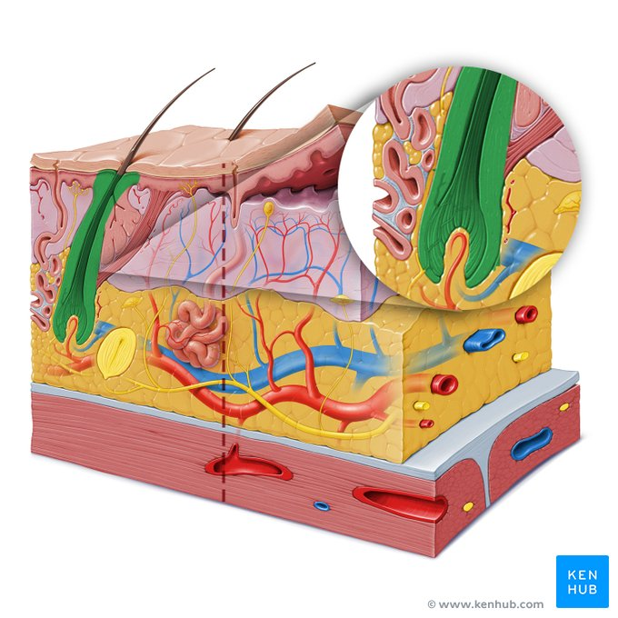
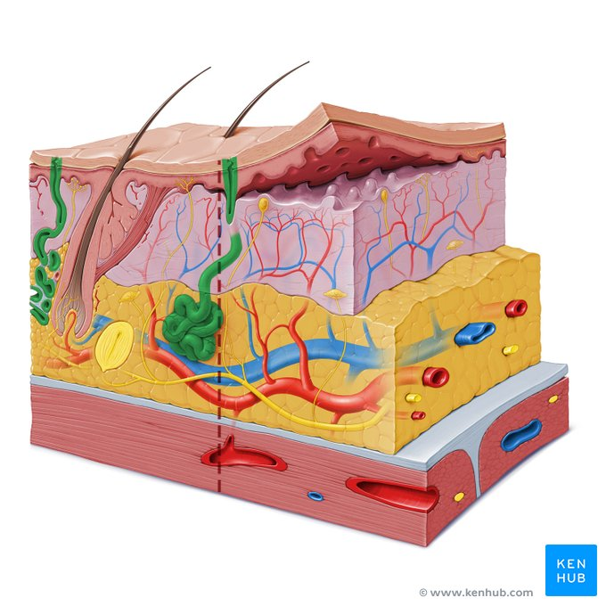
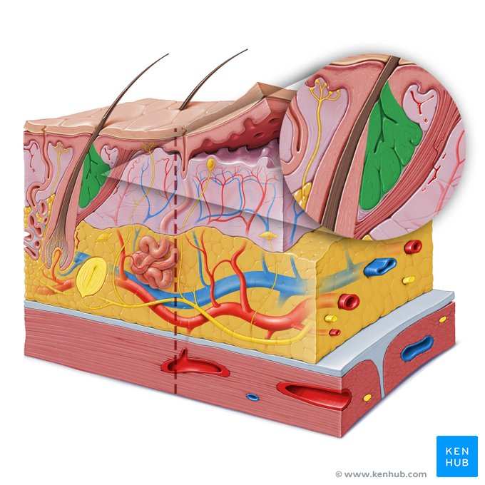
Dermis: Illustrations of a tactile Meissner corpuscle. A tactile corpuscle (corpusculum tactus) such as the Meissners corpuscles facilitate the sensorial capabilities of the skin such as light touch, low frequency vibration. - Ilustration of free nerve endings, hair follicles, sweat glands, sebaqueous glands.

Slide 15
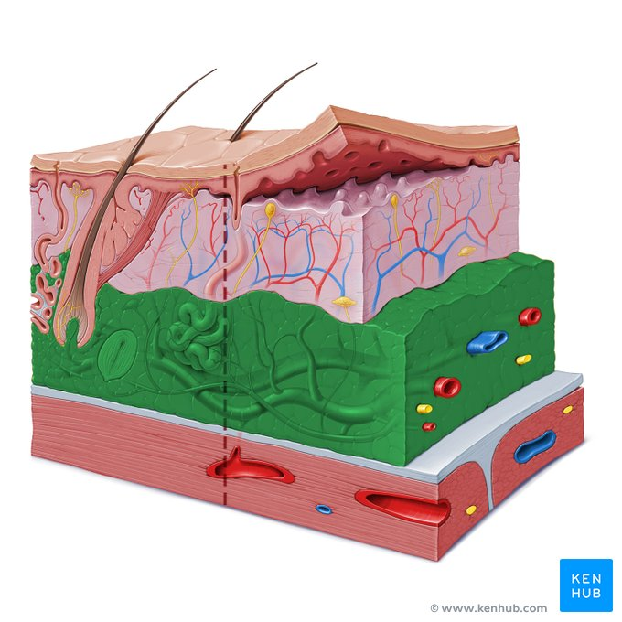
Subcutaneous Tissue
Adipose or hypodermis layer
Innermost layer of the skin, various thickness
It is composed of:
adipose tissue (energy storage, shock absorption). The thicker the adipose layer, the poorer the blood supply through it.
blood vessels (thermoregulation), subcutaneous vascular plexus. loose connective tissue
nerve tissue (cutaneous nerves): provide sensory skin innervation – sensory receptors. Ex. lamellar corpuscles = Pacinian corpuscles detect pressure and high frequency vibrations.

Slide 16
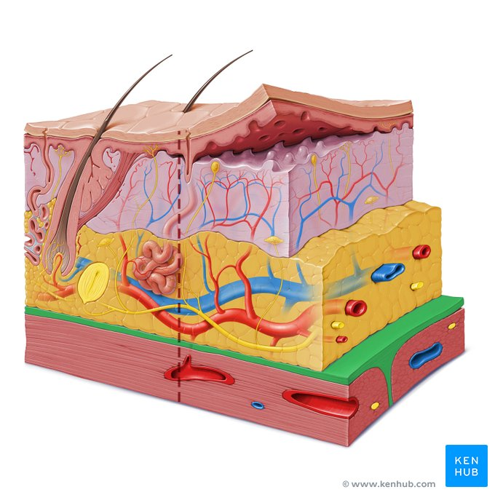
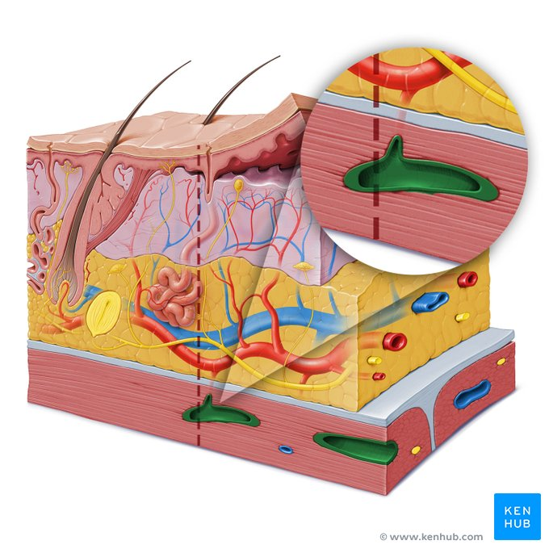
Fascia: separates the subcutis from the underlying muscle. It is a thin layer of fibrous connective tissue, protects the muscles and helps reduce friction. Muscle layer: contains intramuscular arteries and veins.

Slide 17
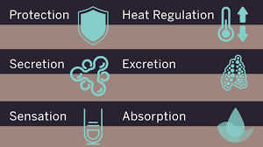
Function of Skin
Six primary functions:
Temperature regulation
A sensory organ for pain, temperature, and touch
Eliminates waste
A protective barrier between internal organs and the external environment
Synthesis of Vitamin D
Social interaction

Slide 18
Temperature Regulation
Thermoregulation accomplished through combined function of nerves, glands, and blood vessels
When skin exposed to cold:
Blood vessels constrict and blood flow reduced to skin
Body temperature falls
Body conserves heat
When skin exposed to heat:
Blood vessels dilate and blood flow increased to skin
Body temperature rises
Sweat production increases allowing body to cool

Slide 19
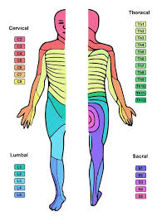
Sensation
Nerve endings in skin sense:
Pain
Pressure
Temperature
Nerve fibers (which originate in nerve roots in the spine), supply the skin, (Dermatomes)
Loss or reduction in sensation increases risk for injury
Tactile corpuscles (corpusculum tactus) such as the Meissner corpuscles facilitate the sensorial capabilities of the skin such as light touch, low frequency vibration and other sensations.
Lamellar corpuscles such as the Pacinian corpuscles detect pressure and high frequency vibrations.

Slide 20
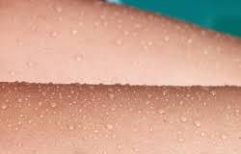
Waste Elimination
Excretes:
Waste products
Electrolytes
Water
Average adult looses 500mL water through skin per day
2 million skin pores release water and body waste to air

Slide 21
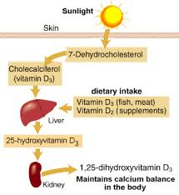
Vitamin D Synthesis
Vitamin D assists in mineralization of bones and teeth
Vitamin D that is synthesized in skin is transferred to other parts of body

Slide 22
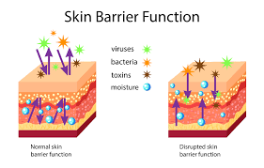
Skin Barrier
Barrier to:
Trauma
Bacterial invasion
Excessive loss of fluids and protein
Also protects tissues and underlying structures from injury
Skin pigmentation protects against UV radiation

Slide 23
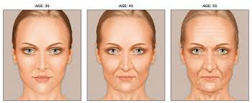
Factors that may impair skin Integrity
• Dryness
• Age
• Nutrition
• Hydration
• Environment

Slide 24
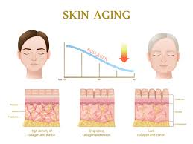
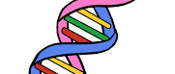
The Aging Process
Biological age does not correlate with chronological age
The rate at which we age is dependent on:
Our genes
Our environment
How we look after our bodies

Slide 25
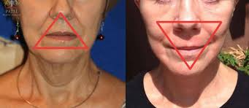
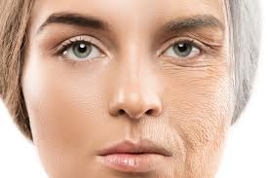
Aging Skin
20% decrease in dermal thickness leads to thinning of the skin
Epidermal-dermal papillae become flattened, increasing susceptibility to friction and shear
Loss of penetrability to substances in the environment – irritants more readily absorbed
Elastin fibers are lost – skin less elastic

Slide 26
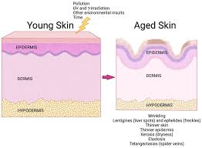
Skin and the effects of aging
• Dermis atrophies:
• Slows wound contraction
• Increases risk of dehiscence
• Diminished dermis vascularity
• Subcutaneous fat atrophies
(most noticeable in face, backs of hands and shins)
• Collagen in the skin reduces (collagen fibers become compressed)

Slide 27
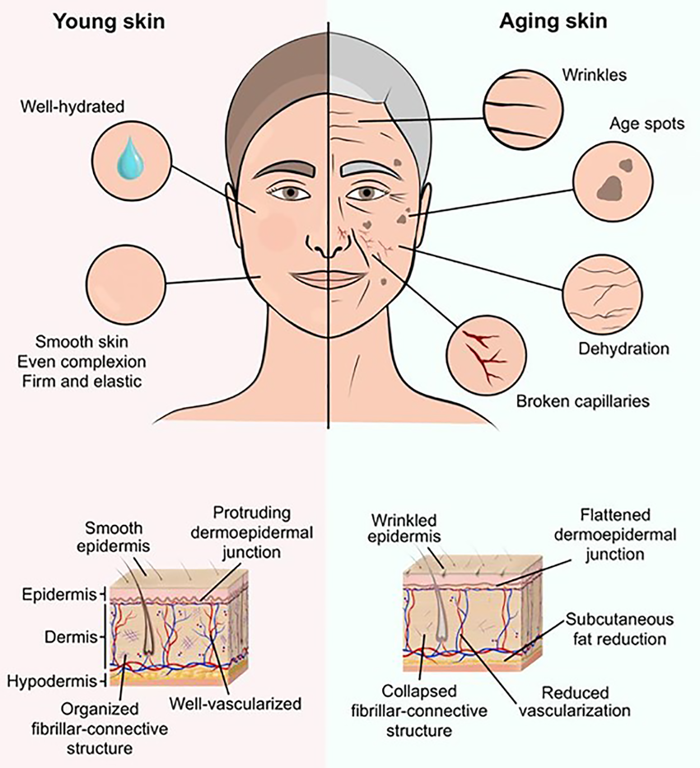
Skin Aging
• Blood vessels become thinner and more fragile causing small hemorrhages called senile purpura
• Reduction in sweat glands and sebum resulting in decreased skin hydration (dry, itchy, inelastic skin)

Slide 28
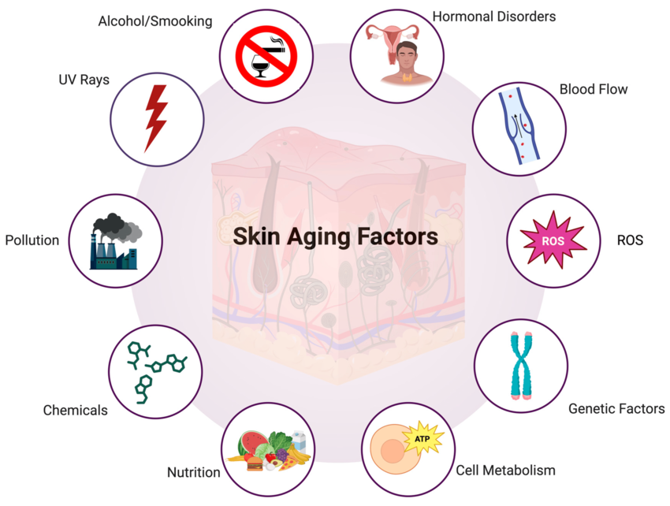

Slide 29
Examples of skin conditions
Basal cell carcinoma: Arises from the stratum basale of the epidermis
Squamous cell carcinoma: Involves the squamous cells of the stratum spinosum
Melanoma: Type of malignant skin cancer that involves melanocytes
Naevi = moles , congenital or acquired that are caused by a benign overgrowth of melanocytes.
Psoriasis: Autoimmune condition causing pink scaly plaques all over the body. Treatment: phototherapy, immunosuppresants, topical agents and alternative therapies.
Eczema: atopic dermatitis. A dry inflammation of the skin. It has been linked to asthma and hay fever. Treatment: Steroid creams and moisturizers.

Slide 30
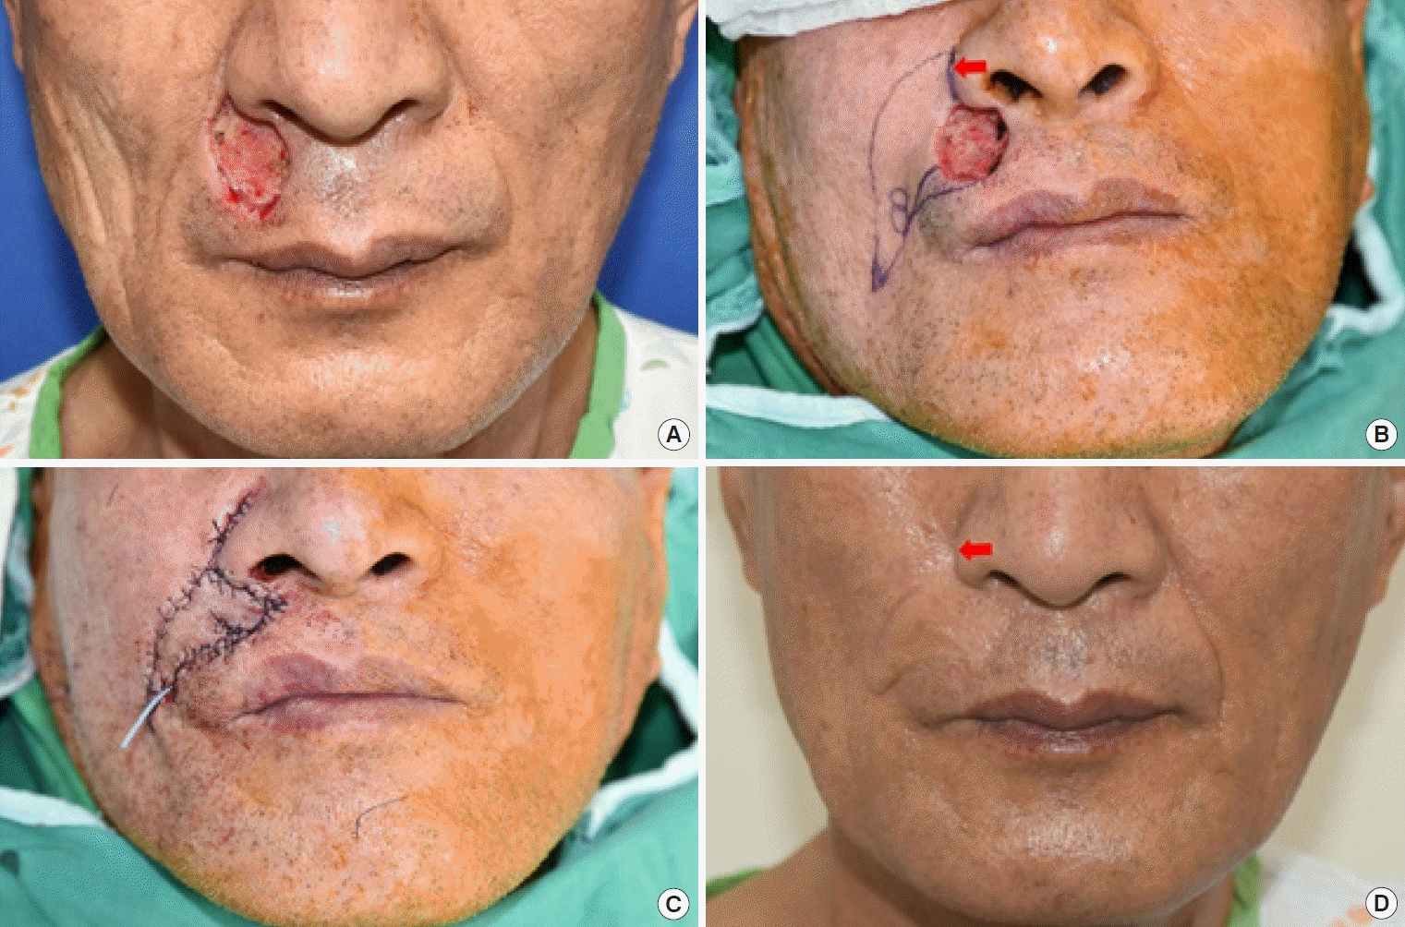
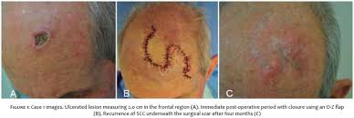
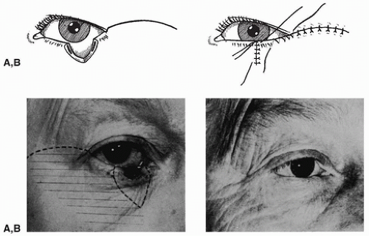
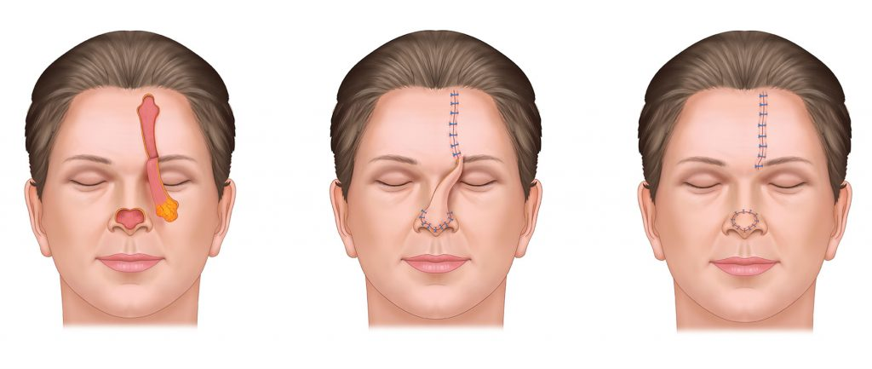
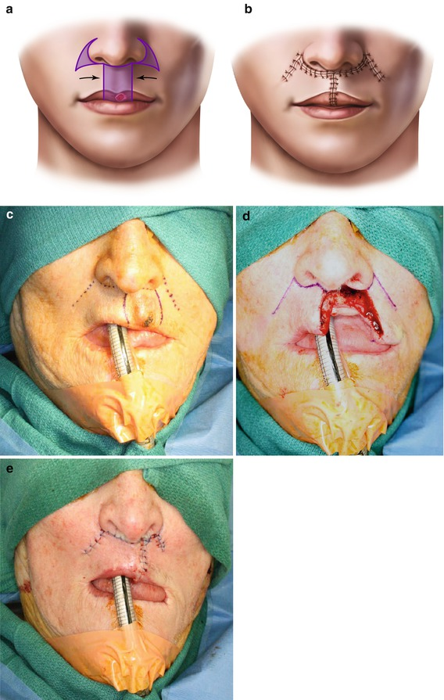
Most common skin cancers – Surgical treatment
MELANOMA
SCC
BCC

Slide 31

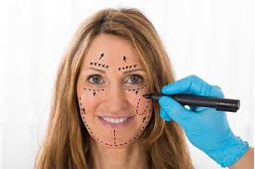
Questions
Thank you

